Slide 1
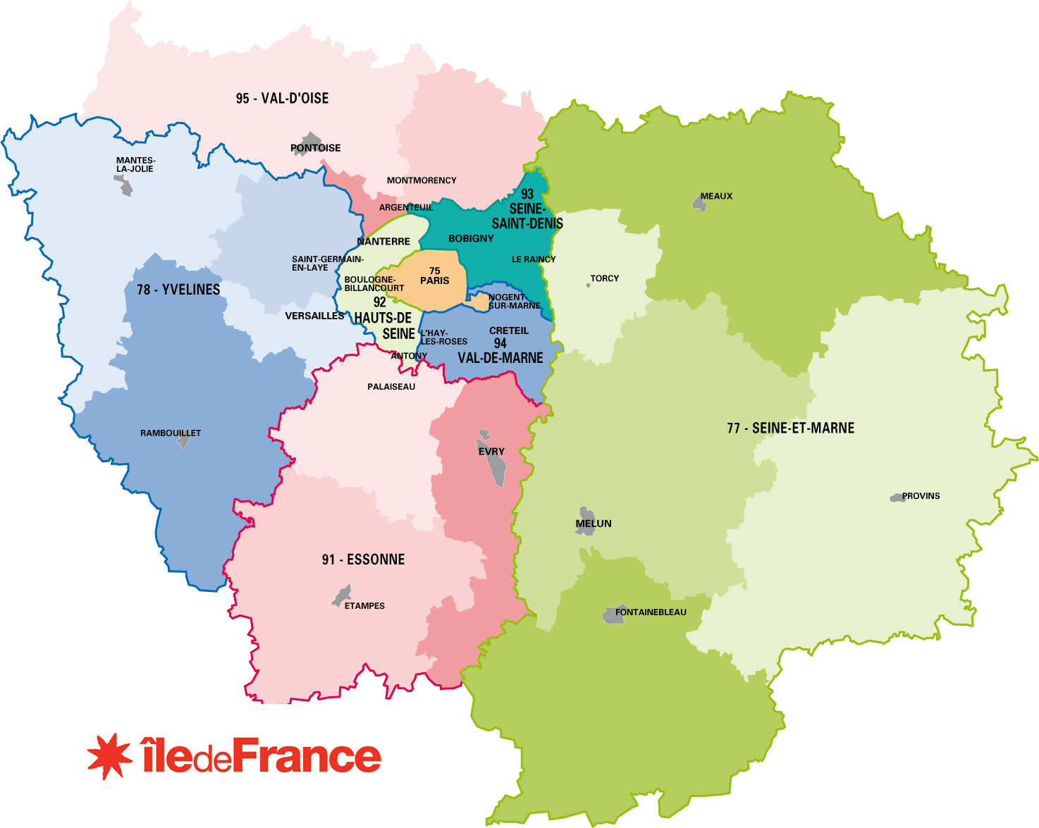

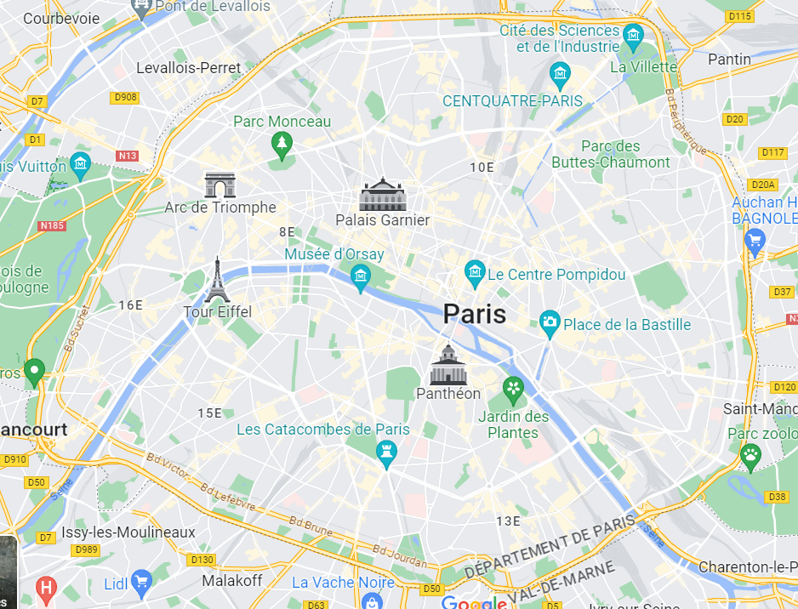

Peace Watchers

Slide 2


Peace Citizens
7
7
7
7
7

Slide 3
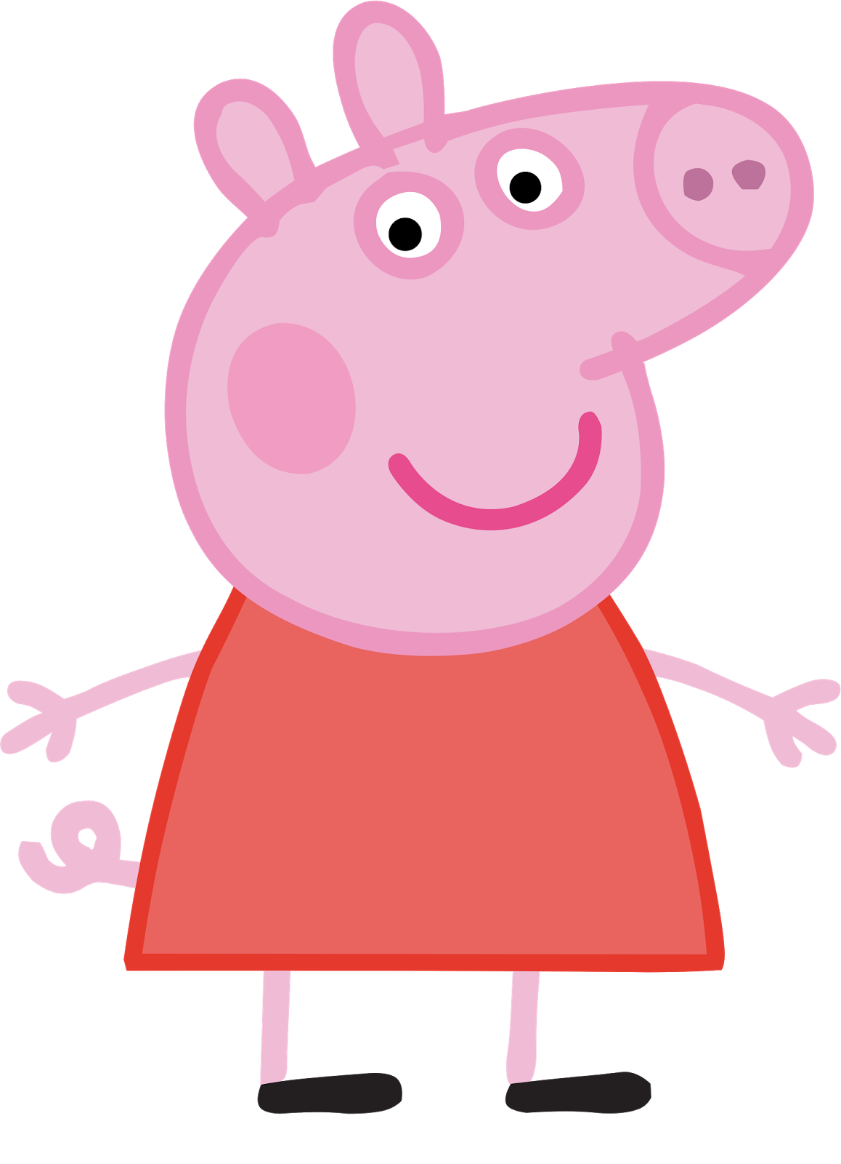
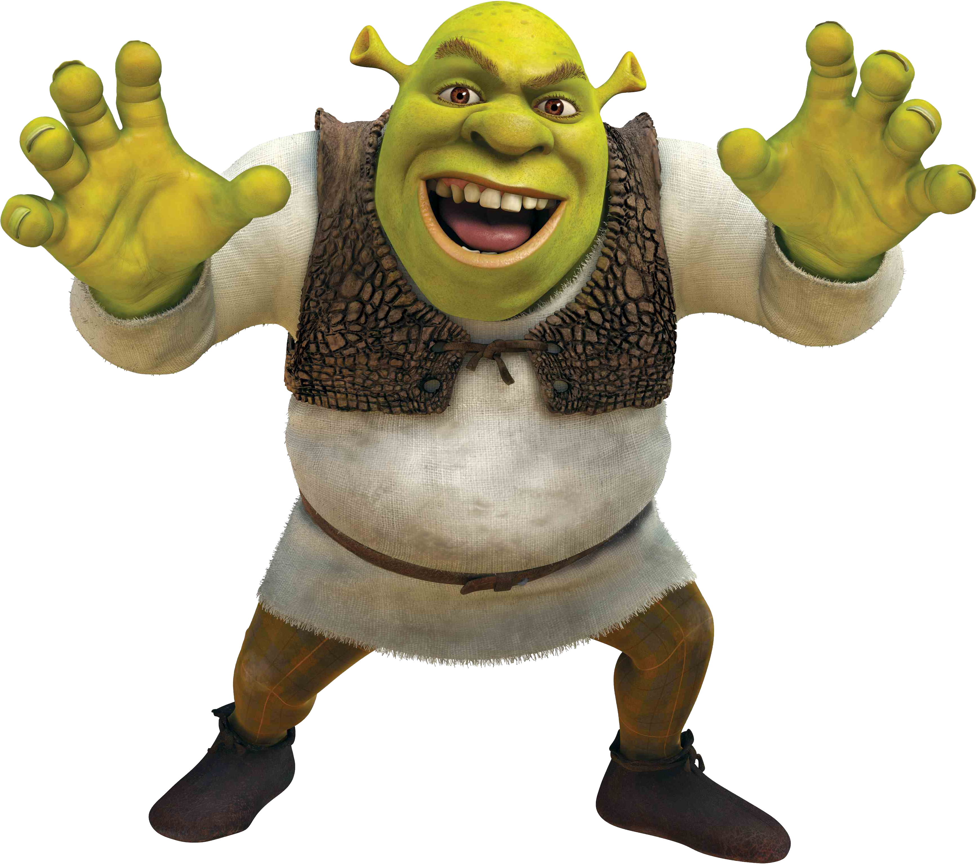
Peace Citizens
9
+1
Quoi ?
Quoicoubeh
4
-1
Cooldown Bonus
Injuries
Malus

Slide 4
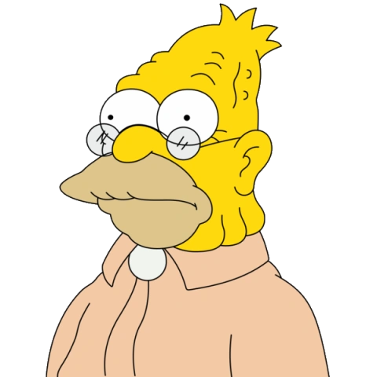




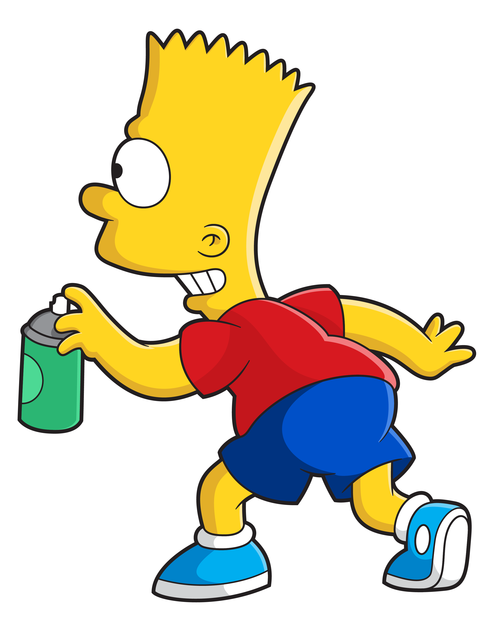

Peace Statistics

